Slide 1
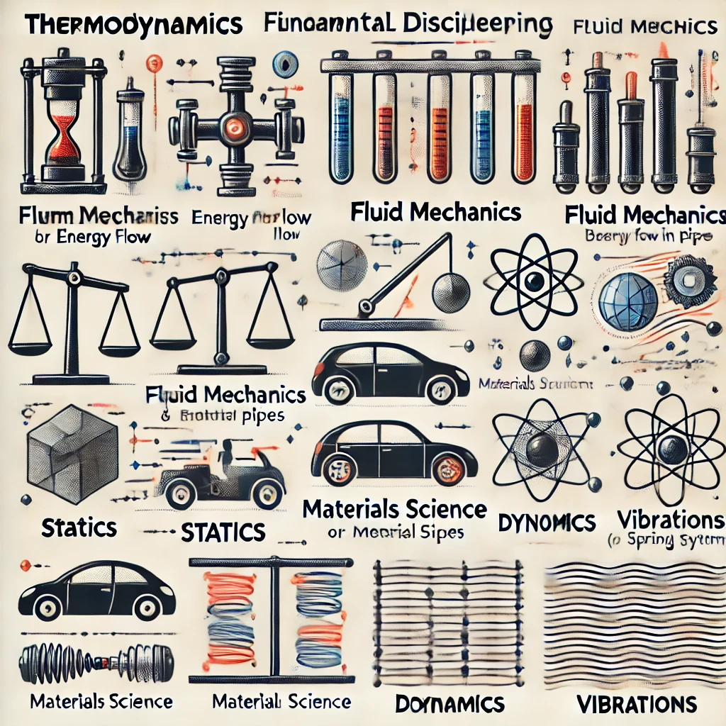

標題叫啥??
教授: 詹魁元
學生: 吳家安、李京睿、王邑安

Slide 2
Introduction
Methods
Results
Discussion

Slide 3
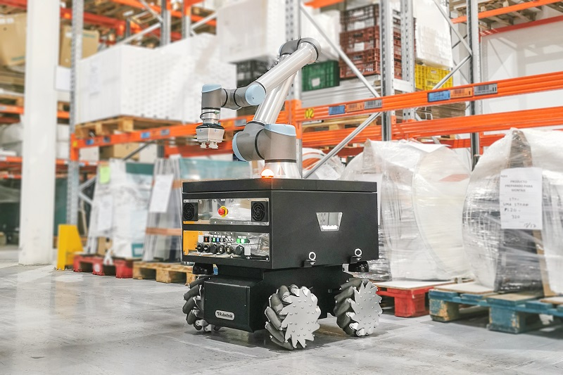
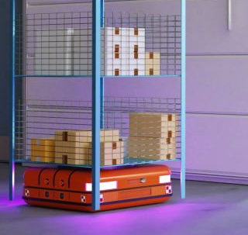
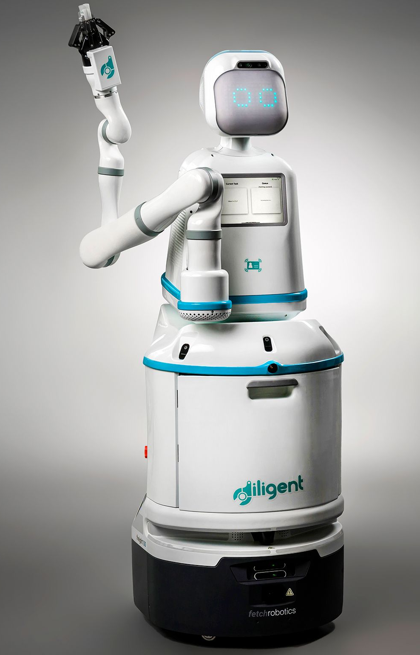


Autonomous Mobile Robots (AMR)
Motion Planning
Introduction
Methods
Results
Discussion

Slide 4
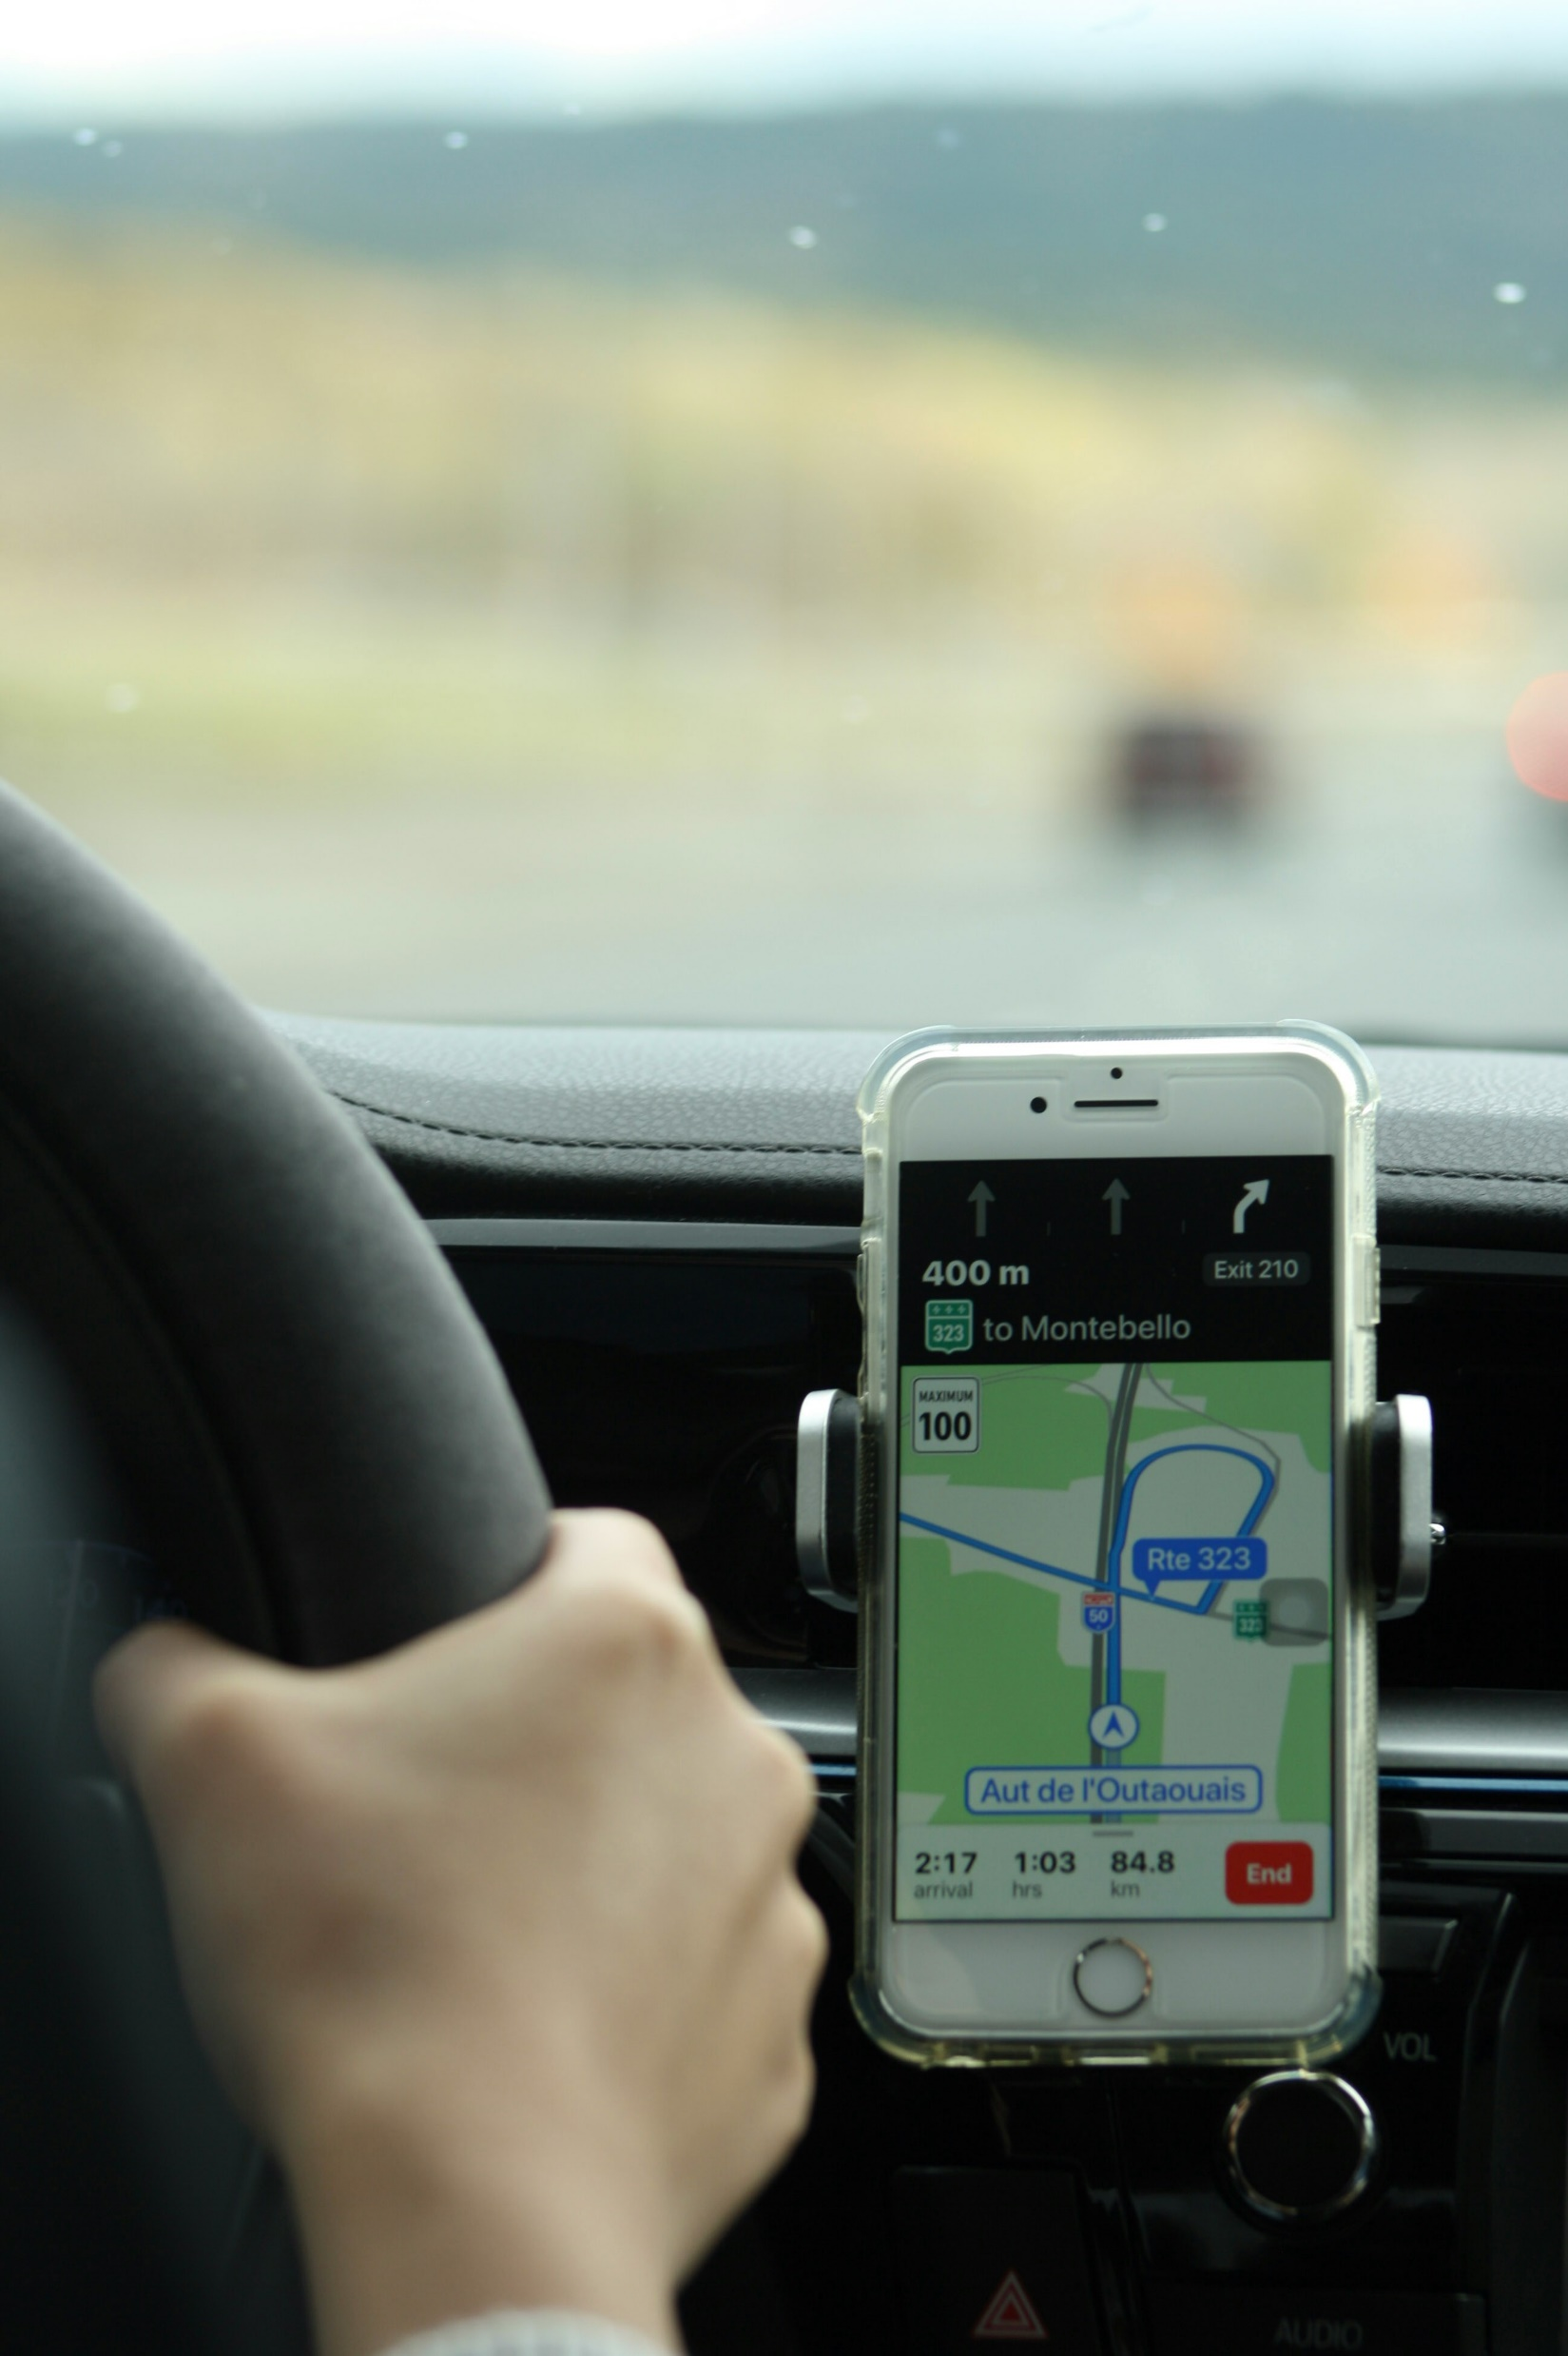
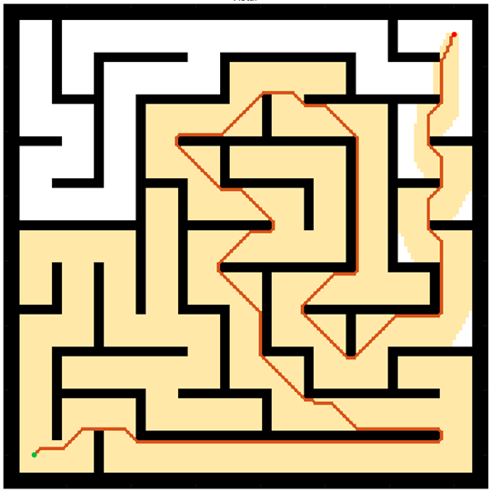
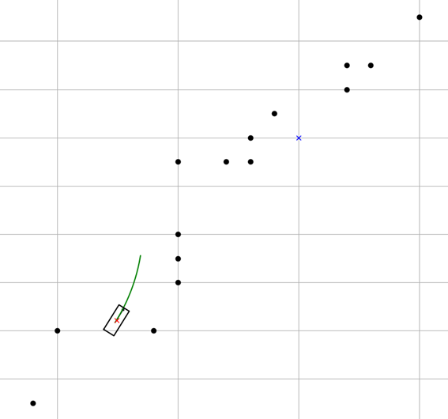
Motion Planning
Motion Planning finds a continuous sequence of valid configurations that safely and efficiently guide a robot from start to goal.
Global Planning
Navigation
Avoiding Static obstacle
Local Planning
Handle emergency
Evading moving objects
Google Map
Global Planning
Driver
Local Planning
Introduction
Methods
Results
Discussion

Slide 5
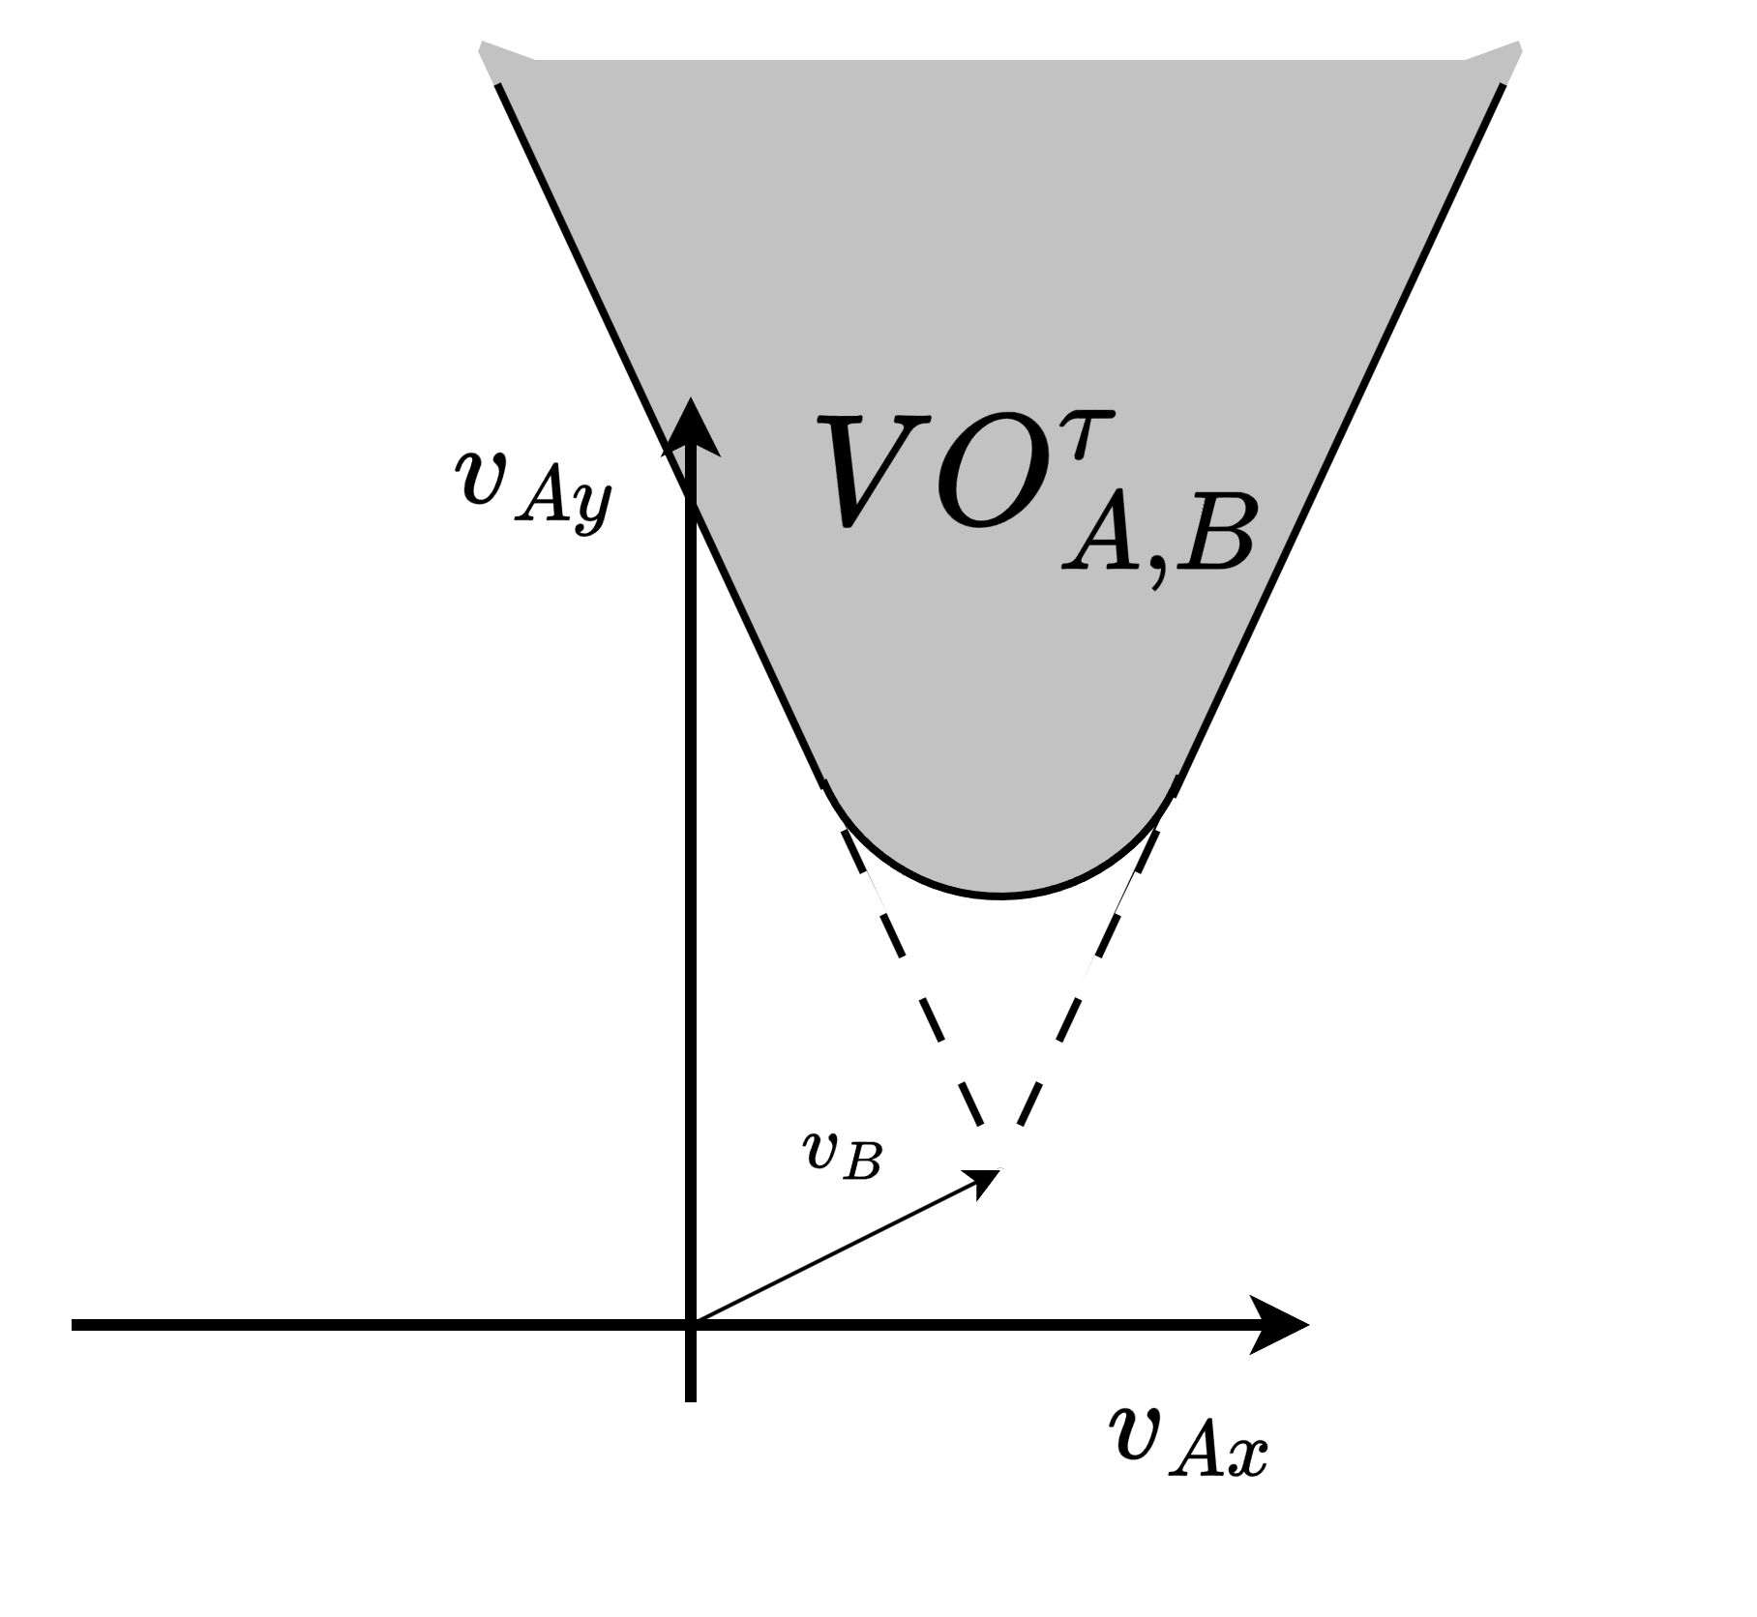
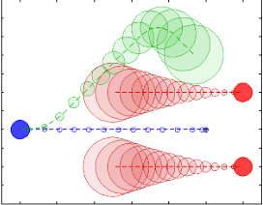
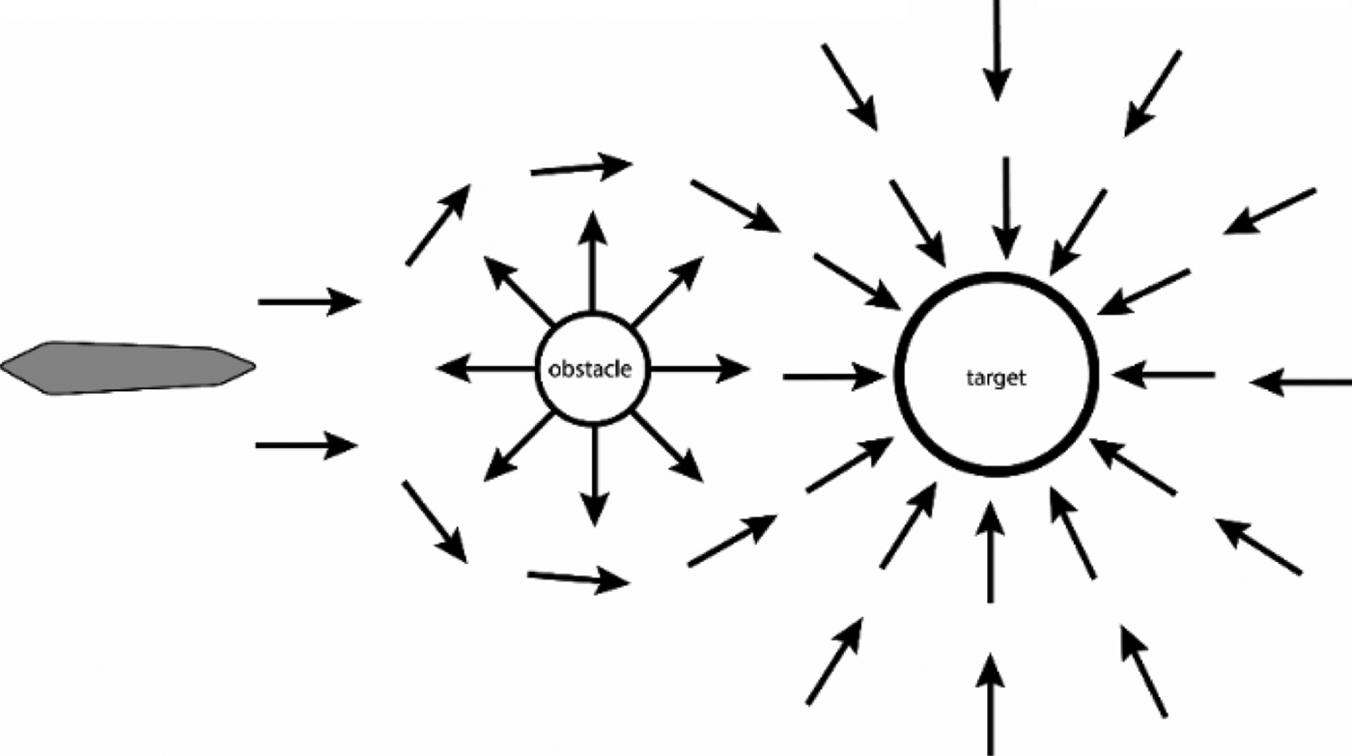
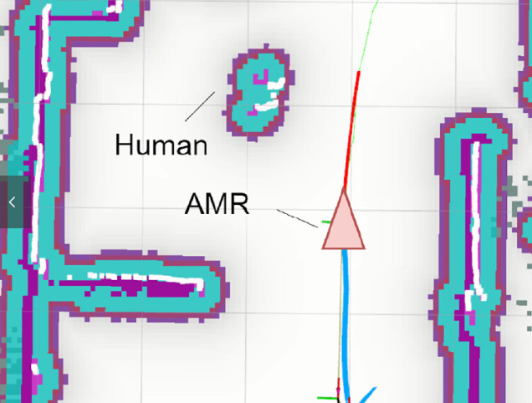
Local Planning
[1] Polvara, Riccardo, et al. "Obstacle avoidance approaches for autonomous navigation of unmanned surface vehicles." The Journal of Navigation 71.1 (2018): 241-256.
[3] Du Toit, N. E. and J. W. Burdick (2010). Robotic motion planning in dynamic, cluttered, uncertain environments. 2010 IEEE International Conference on Robotics and Automation, IEEE.
[2] Wu, C.-H. and K.-Y. Chan (2024). "Developing a dynamic obstacle avoidance system for autonomous mobile robots using Bayesian optimization and object tracking: Implementation and testing." Proceedings of the Institution of Mechanical Engineers, Part C: Journal of Mechanical Engineering Science 238(9): 4007-4022.
Artificial Potential Fields (APF) | Dynamic Window Approach (DWA) | Velocity Obstacles (VO) | Model Predictive Control (MPC)
Simple for real-time avoidance | Effective, Dynamic feasible | Deal with multi-agents systems | Handles robot dynamics
Local minima issue | Struggle with moving obstacles | Poor to handle unknow intension | Computationally expensive
[1]
[3]
[2]
former lab members’ research
My research want to use
Introduction
Methods
Results
Discussion

Slide 6
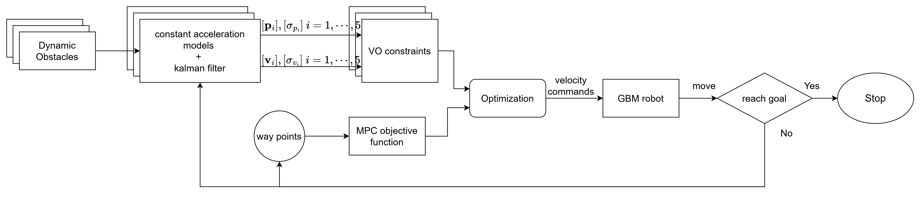
Structure
Prediction step
Optimization step
Introduction
Methods
Results
Discussion

Slide 7
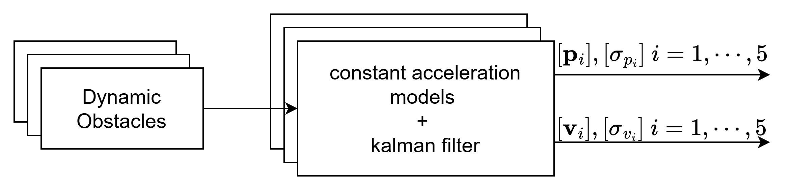

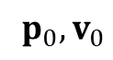
Prediction step
Prediction step
Prediction
$$p_{i},v_{i}, i=1,2,3…$$
$$p_{0},v_{0}$$
Observation
Constant Acceleration Model
Dynamic Obstacle
Introduction
Methods
Results
Discussion

Slide 8
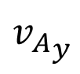
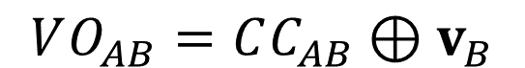
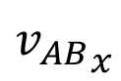
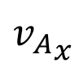
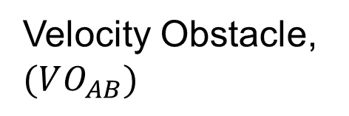
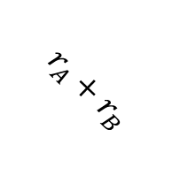
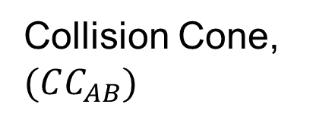
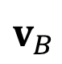
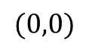
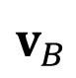
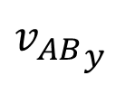
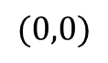
Optimization step -- VO
$$VO_{AB}=CC_{AB}⊕v_{B}$$
C-space
Velocity space
$${v_{AB}}_{y}$$
$${v_{A}}_{y}$$
Collision Cone, $(CC_{AB})$
Velocity Obstacle, $(VO_{AB})$
$$v_{B}$$
$$r_{A}+r_{B}$$
object B
$${v_{AB}}_{x}$$
$${v_{A}}_{x}$$
$$(0,0)$$
$$(0,0)$$
$$v_{B}$$
agent A
Introduction
Methods
Results
Discussion

Slide 9
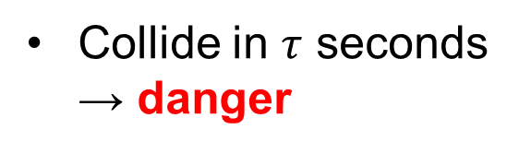
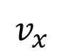
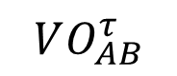
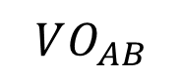
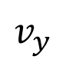
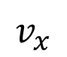
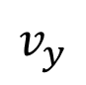
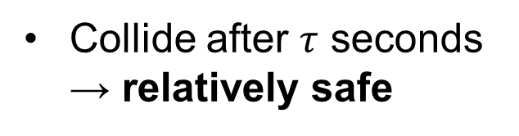
Optimization step -- VO
$$v_{y}$$
$$v_{y}$$
Collide in $τ$ seconds → danger
$$VO_{AB}$$
$$VO_{AB}^{τ}$$
Collide after $τ$ seconds → relatively safe
Ideal velocity
Cut off the relatively safe region
Dynamic feasible region
$$v_{x}$$
$$v_{x}$$
Introduction
Methods
Results
Discussion

Slide 10
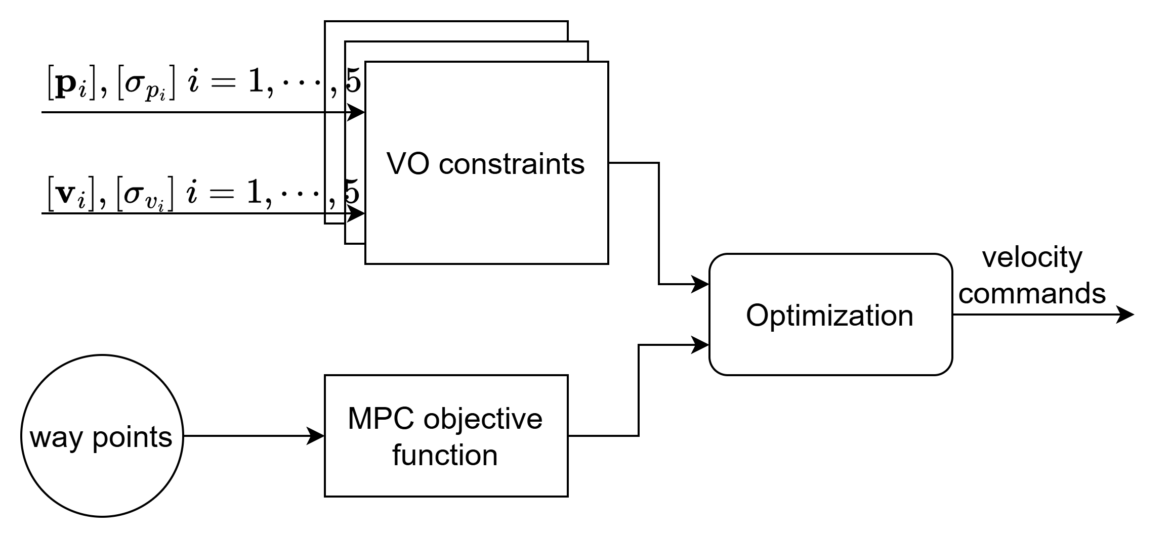
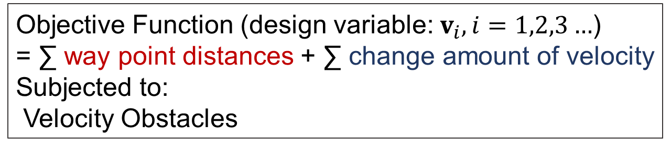
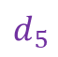
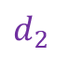
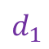
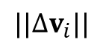
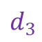
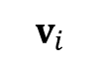
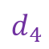
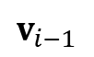
Optimization step
Objective Function (design variable: $v_{i}, i=1,2,3…$)
= ∑ way point distances + ∑ change amount of velocity
Subjected to:
Velocity Obstacles
Way point distances
Way point
Change amount of velocity
$$d_{5}$$
Minimize!
Optimization step
$$d_{4}$$
$${||∆v}_{i}||$$
$$d_{3}$$
$$v_{i}$$
$$d_{2}$$
$$v_{i−1}$$
$$d_{1}$$
Robot
Velocity space
Introduction
Methods
Results
Discussion

Slide 11
What is machine??
Introduction
Methods
Results
Discussion

Slide 12
What is machine??
Introduction
Methods
Results
Discussion

Slide 13
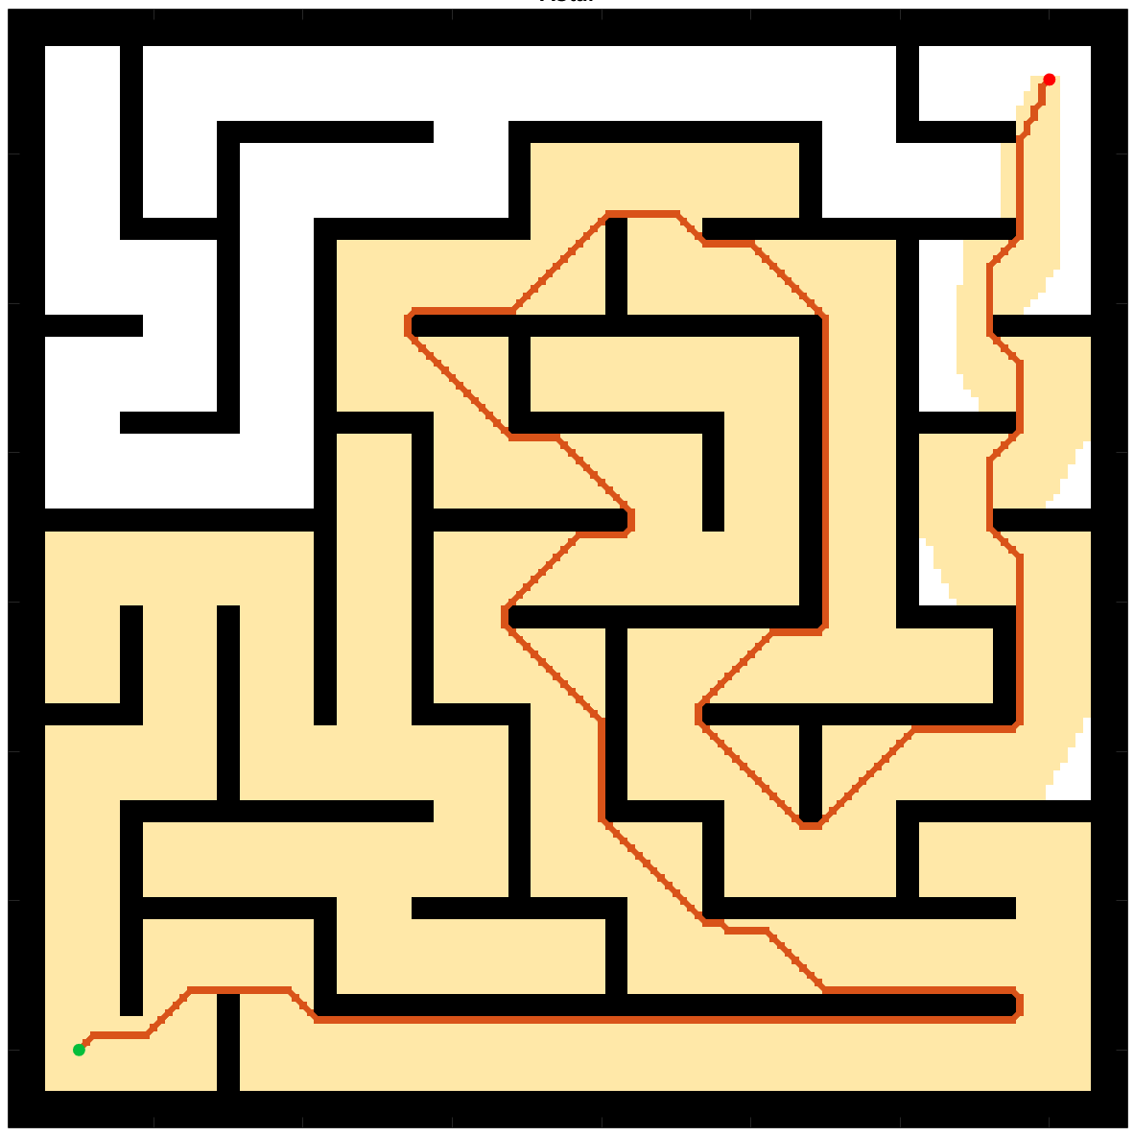
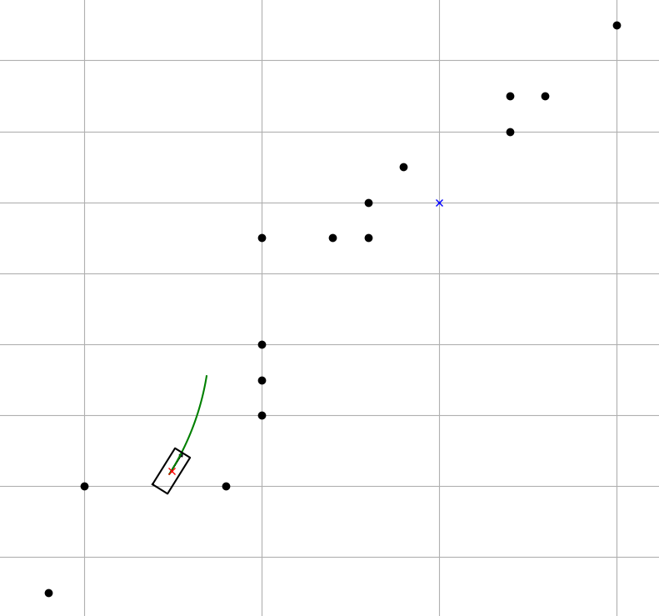
Introduction of Path Planning
B
A
Global Planning
Local Planning
Introduction
Methods
Results
Discussion

